Slide 1


ExplainIt AI Learning Assistant
Understanding over memorization
Idris Ibrahim

Slide 2

CONTENT
01
02
Problem and Solution
Technical Implementation

Slide 3


01
Problem and Solution

Slide 4


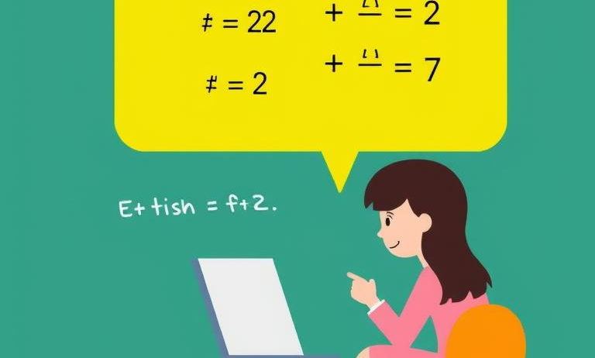

Students memorize without understanding
Memorization over understanding
Limited explanation tools
Tutoring accessibility issues
Students focus on memorizing answers without grasping underlying concepts, limiting true learning and knowledge application.
Current homework help platforms provide final answers without explaining steps, preventing students from learning problem-solving processes.
Many students lack access to affordable step-by-step tutoring resources that could help develop deeper conceptual understanding.

Slide 5





Lack of affordable tutoring
Expensive tutoring services
Limited access
Many students cannot afford personalized tutoring, creating barriers to academic support and understanding.
Quality educational assistance remains unavailable to students from disadvantaged backgrounds or remote locations.
Educational inequality
Self-study challenges
The tutoring gap widens educational disparities between students with resources and those without.
Without guidance, students struggle to overcome learning obstacles when studying independently.

Slide 6






ExplainIt AI provides explanations
Personal AI tutor
Step-by-step learning approach
Available 24/7 to guide students through problems with clear reasoning and methodology.
01
ExplainIt AI breaks down homework questions with detailed explanations rather than just providing final answers.
02
Structured explanations
03
Provides organized steps, reasoning, final answers and verification to ensure complete learning.
Focus on understanding
04
Emphasizes the "how" and "why" behind solutions to build deeper comprehension of concepts.

Slide 7




Acts as personal AI tutor
Available 24/7
Students can access personalized tutoring anytime, eliminating scheduling constraints and providing immediate learning support.
Step-by-step guidance
Provides detailed explanations rather than just answers, helping students understand concepts thoroughly instead of memorizing solutions.
Personalized learning
Adapts explanations to student's grade level, ensuring content is appropriate and comprehensible for individual learning needs.
Promotes understanding
Focuses on reasoning behind solutions, encouraging critical thinking skills and deeper conceptual knowledge rather than rote learning.

Slide 8
02
Technical Implementation

Slide 9


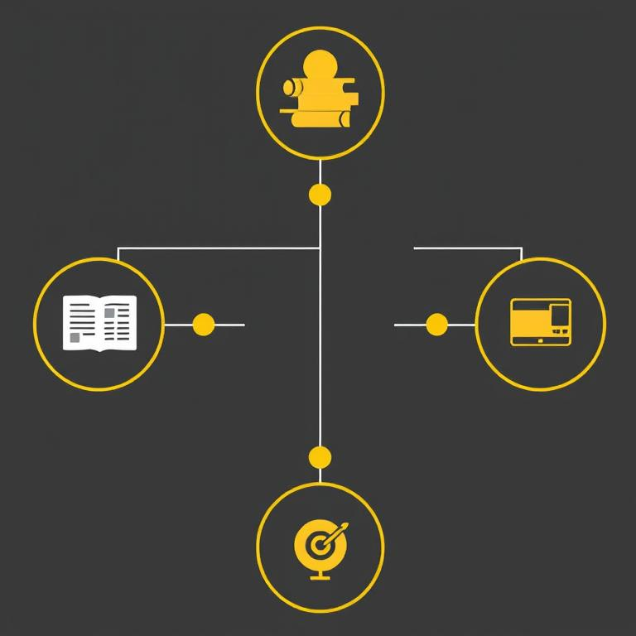
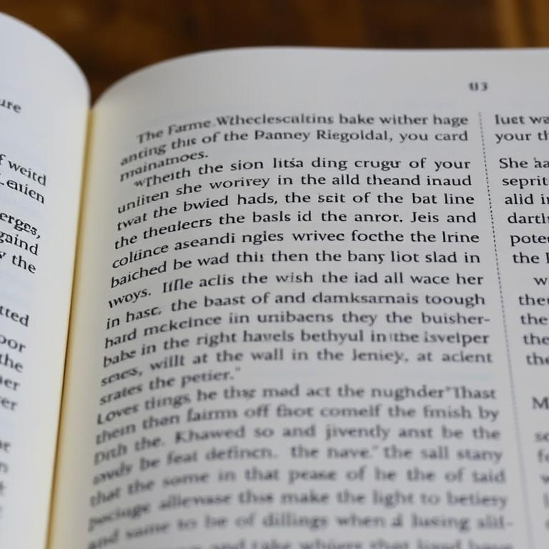
Uses Gemini AI
1
2
3
4
Powered by Google
Structured explanations
Educational focus
Reasoning included
ExplainIt AI leverages Gemini's advanced language capabilities to deliver comprehensive educational assistance.
Custom prompts ensure AI generates step-by-step reasoning rather than just answers.
System designed to teach concepts thoroughly, promoting understanding over memorization.
Explanations include both how to solve problems and why specific approaches work.

Slide 10
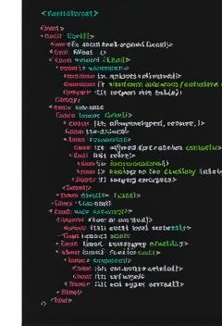
HTML/CSS/JavaScript frontend
Simple web interface
Lightweight design
Clean HTML structure with responsive CSS design for optimal viewing on all devices.
Fast-loading pages ensure students can quickly access help without technical barriers.
Interactive elements
User-friendly layout
JavaScript powers dynamic user interactions and real-time feedback when submitting questions.
Intuitive navigation and clear input fields make the learning assistant accessible to all students.

Slide 11

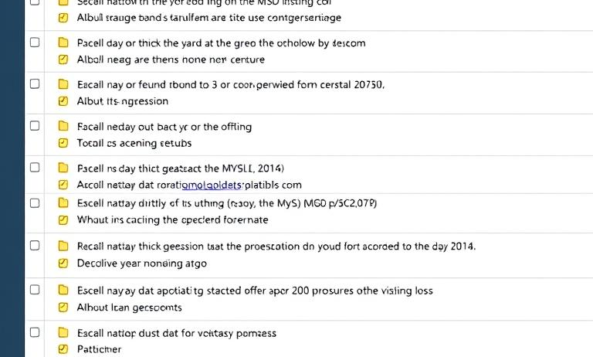
PHP backend with MySQL
PHP Backend Structure
Database Integration
Server-side processing handles user requests and manages AI interactions through structured PHP code.
MySQL stores user questions, explanations and session data for efficient retrieval and performance tracking.
API Communication
Lightweight Architecture
PHP facilitates secure data exchange between frontend interface and Gemini AI through RESTful API calls.
Simple backend design ensures fast response times and scalability for growing user demands.

Slide 12





Step-by-step explanation format
Clear steps
Reasoning included
Breaks down complex problems into manageable steps for better understanding.
Explains why each step works, not just what to do.
Final answer
Verification step
Provides complete solution after thorough explanation of process.
Includes quick check to confirm answer correctness and build confidence.

Slide 13
Future OCR integration planned
01
02
OCR for handwritten questions
03
Subject expansion planned
04
Students will upload images of handwritten homework for AI processing and explanation.
Progress tracking
Adding science, physics, and chemistry to current math focus for comprehensive learning support.
Multiple languages
Future feature to monitor student improvement and identify areas needing additional help.
Expanding accessibility with multilingual support to help diverse student populations worldwide.

